Slide 1
Connecting Programmatic Learning Objectives with Practice: Insights from an Analysis of Workforce-Based Assessments
Phil Reeves
preves@nbme.org
John Moore
jmoore@nbme.org
3.6.26

Slide 2

Agenda
Welcome
Project Overview
Findings
Lessons Learned
Discussion of Best (Better) Practice

Slide 3
Introductions
National Board of Medical Examiners
NBME advances assessment of health care professionals to achieve optimal care for all.
The mission encompasses the spectrum of health professionals along the continuum of education, training and practice and includes research in evaluation as well as development of assessment tools.
We design assessments and tools that serve as catalysts for growth, providing opportunities for all students to demonstrate their knowledge and skills.
Growth and Innovation – Unit examining skills and behaviors in the formative space.
Educational Strategy – Department connecting research with education practice

Slide 4
Learning Outcomes
By the end of the session, participants will be able to:
describe how medical schools use Workplace‑Based Assessments (WBAs) to evaluate student competency in three competency areas
identify and compare patterns in the presented WBA data and assessment methods with those used at their own institutions
begin formulating a plan for improving assessment practices to ensure alignment between learning objectives, observed student performance, and institutional assessment goals.

Slide 5
Workplace Based Assessments
Evaluation of medical student performance in a clinical (patient care) setting through direct observation by other health care professionals.
Can be used for both procedural (e.g. physical assessment of patients) and behavioral (e.g. communication skills)
Rubric based and primarily formative for students in during their clinical rotations.
Assessment of actual practice in an actual scenario.
Workplace-based assessment in healthcare: Key concepts and best practices - Chaoyan Dong, Siew Ching Low, Clement C Yan, 2024

Slide 6
WBA Data Creative Community
NBME’s Creative Community Model
Why WBA Data?
Challenging Area for Schools
NBME Prioritized Areas: Clinical Reasoning, Communications, Teamwork (HSS)
NBME’s potential for contribution
Project Goals
School measurements of WBA
Develop understanding of school needs / possible contributions
Ask
4 year’s worth of WBA data
Instrument copies
Feedback on data analysis and visualization

Slide 7
Summary: Differences Across Schools
Rating scales varied
(2-point scales)
(4-point scales)
(4- and 5-point scales)
(4-, 5-, and 9-point scales)
(10-point scales)
2. Number of questions per construct varied
(CR = 14, Comm = 12, Teamwork = 3)
(CR = 4, Comm = 2, Teamwork = 3)
(CR = 9, Comm = 5, Teamwork = 4)
(CR = 36, Comm = 24, Teamwork = 6)
(CR = 8, Comm = 3, Teamwork = 1)
3. The degree of standardization across courses and forms varied (central vs distributed approach).
4. The number of ratings per student varied
(Avg. = 289.8)
(Avg. = 141.6)
(Avg. = 89.6)
(Avg. = 143.8)
(Avg. = 189.79)
5. Some unique qualitative themes were identified.
Digital Literacy
IICARE

Slide 8
Summary: Similarities
High consistency of ratings across different forms within each school
Low variation – majority of ratings (92.1%) on the positive half of each rating scale
5.4% of Ratings were N/A
62.5% of ratings were at the highest point on the scale
0.15% of ratings were at the lowest point on the scale
Construct Coverage
Clinical reasoning – Most coverage
Teamwork – Least coverage
Generally, teamwork was the highest rated skill, and clinical reasoning was the lowest rated skill.
4. Relationship between quantitative and qualitative data (fewer questions on a topic led to more comments) and additional common themes were identified across multiple schools
Leadership
Professionalism
Patient Care

Slide 9
The number of questions per construct varied

Slide 10
Variation in Distribution of Ratings

Slide 11
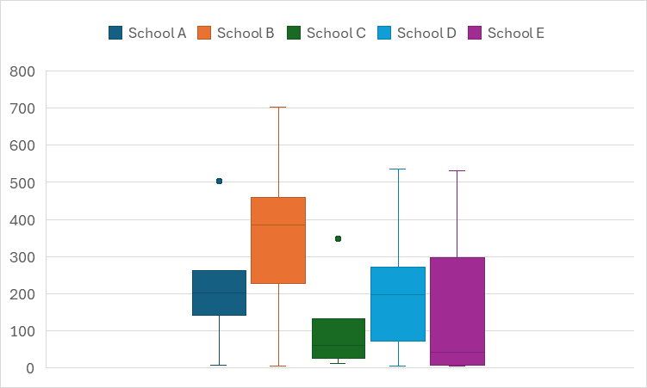
Variation in Number of Ratings Per Student* **
* ”Ratings” in the context of this graphic are counted at the question level (i.e. a single form with 50 completed questions for a student would count as 50 ratings).
** Ratings are inclusive of all students, regardless of number of clinical rotations completed and may include students with limited opportunity for feedback.

Slide 12
Qualitative Data Comparisons
Negative Comments were between 2 and 5%

Slide 13
Discussion
How closely do these results reflect behavioral assessments that are conducted at your institution?
Was any of the data or the summary surprising?
If these findings were from a department at your institution, what, if any, changes would you make to your assessments or assessment processes?

Slide 14
Discussion
If only the top-half of scales are used by raters, what are some recommendations for modifying the measurement instruments?
How would you interpret the proportions of “top-box” ratings?
How well does it reflect true performance?

Slide 15
Discussion
How aligned are your institution’s current assessment instruments with your stated assessment goals (e.g., formative feedback, competency tracking, identifying struggling learners)?
What are some best practices for maintaining (or improving) that alignment over time?

Slide 16
Best (Better) practice
Align instrument design with intended data collection goal(s)
Formative feedback
Monitoring growth over time
Minimum competency / identifying those at most risk
Appropriate construct coverage / alignment with learning objectives
Department or course assessment vs. programmatic assessment
2. Communicate the goal(s) to faculty and students
Intended interpretation of rating points
Specificity of questions (e.g. asking for places for development)
3. Review data and data and collection procedures
Consider available resources – consistency
Leverage new data analysis techniques/methods
Obtain raw data instead of summary reports, when possible

