Slide 1
Beyond a Checklist
Rethinking Rubrics to Honor the Process of Learning
Melissa E. Ko, Tara Mason, Rachel Weiher, Courtney Gomas
Center for
Teaching &
Learning
Notes:
Rubrics can support equitable teaching and learning, but also unintentionally encourage checklist thinking and disincentivize deeper engagement. Pressure to over-specify criteria in the name of fairness or objectivity may flatten complex skills that require inherently subjective expert judgment. Generative AI adds further challenges for rubrics by producing polished outputs that appear to meet standards without contributing to students' learning process. This conversation explores how we have adapted the AAC&U VALUE rubrics based on student, instructor, and expert input, as well as ongoing challenges we face in redesigning assignments to align with a focus on process, metacognition, and reflection.

Slide 2
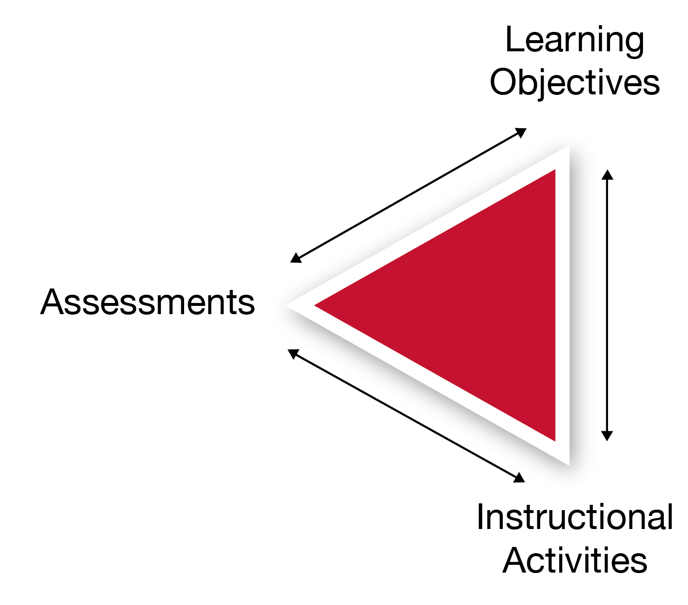
GenAI invites (if not demands) that we interrogate our learning goals and assessment strategies.
Given the rise of GenAI:
What are students supposed to get out of a college education?
How do we assess what students are actually learning in courses?
Goals => Rubrics => Assignment Prompts
Notes:
We need to question our goals (purpose/mission), our standards we set for students, and the way we design assignments to prompt students to demonstrate what they can do
Important to promote transparency, trust, and equity in our course design

Slide 3

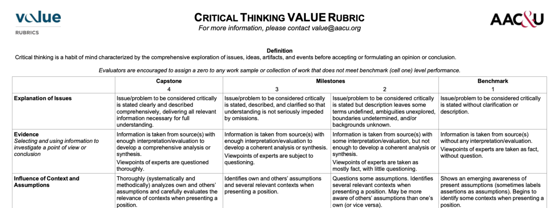
Critical thinking and information literacy are widely considered essential skills in a college education.
What do students / instructors think of these rubrics?
Notes:
Why are rubrics so important? - they set the goals, communicate them to students, explicit about what students need to do and to what level of performance
AAC&U has developed reliable and validated instruments for assessing these two skills
Consist of five criteria each or sub-skills (critical thinking itself is a complex/multifaceted skill)
Available under a creative commons license for all educators/institutions

Slide 4
We invited a diversity of instructors / students to participate in stratified focus groups on GenAI.
Recruitment
Pre-Survey
Focus Group
36% Asian and 18% Hispanic/Latine
9% trans/gender-nonconforming and 66% women
~25% first-generation and/or low-income
14% living with a disability
Plus a partnership with our University Libraries!
Notes:
What do
We had an alternative longer follow-up survey for those unable to attend the focus group
Asked similar questions to individuals in a survey format over Qualtrics

Slide 5
Conversations surfaced broad concerns around established rubrics in the presence of GenAI.
Students mapped rubric criteria to components of an essay.
Both groups identified certain criteria as less important now.
Both groups felt that some important aspects were left out.
Both groups identified certain criteria as okay to let a GenAI do instead.
Both groups thought GenAI could pass as competent in most criteria.

Slide 6
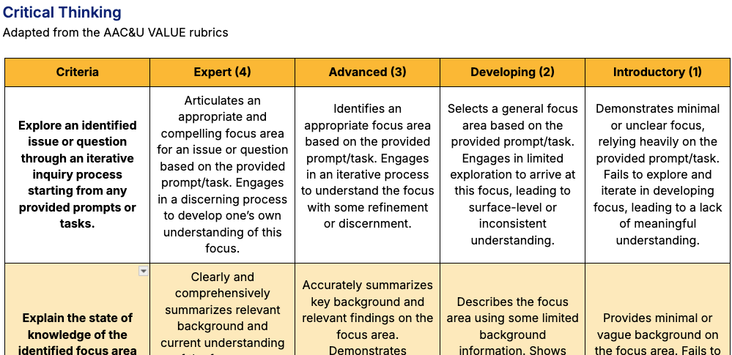
We revised AAC&U VALUE rubric standards to reflect more “human” outcomes.
Notes:
De-emphasize areas that are NOT valued - particularly by both groups
De-emphasize areas that are seen as replaceable by GenAI
Think about how to better communicate value when students don’t see intrinsic value
Consider honoring what students DO value
Address misconceptions about what GenAI is/how it works, and its strengths/weaknesses
Revised AAC&U VALUE Rubrics
https://docs.google.com/document/d/1jnDKneXsgaHNCJtI_8i7kY7CLB7Z3REY31LtrHQN4o4/edit?usp=sharing

Slide 7
Partnerships with instructors have revealed opportunities to rethink assignment design.
Fall 2025 Pilots | Spring 2026 Pilots
THEATER R1B | COLWRIT R4B (+ R1A / R4A)
COLWRIT R1A | HISTORY 7B
COLWRIT R4A | ASAMST 20A
SOCIOL 102 | EDUC C142
RHETOR 137 | GEOG 103
HISTART 190M | SOCIOL 167

Slide 8
Calibrating assignments to these new rubric criteria has surfaced multiple challenges.
Misalignment of intended goals and assignment instructions
Lack of prompts for process pieces or metacognition
Exclusion of uniquely human and critical aspects
Loss of vital emphasis on information literacy as a habit of mind
To what extent will a deep learning process be incompatible with any product?
Notes:
Revised AAC&U VALUE Rubrics
https://docs.google.com/document/d/1jnDKneXsgaHNCJtI_8i7kY7CLB7Z3REY31LtrHQN4o4/edit?usp=sharing

Slide 9

Thanks for listening!
Follow our progress on this project: teaching.berkeley.edu/genai-valued-learning-project
AI FAST team: Melissa Ko, Rachel Weiher, Tara Mason, Courtney Gomas, Maya Wu, Carys Atmodjo, Breanna Cabusao, Jenae Cohn, Prof. Ula Taylor
This project was funded by the California Education Learning Lab, a state-funded grantmaking organization with a mission to improve learning outcomes and close equity gaps for students attending public higher institutions in California.
Center for
Teaching &
Learning

