Slide 1
Assessing Experiential Learning in Higher Education
&
October 4th, 2024
SLO-Talks

Slide 2
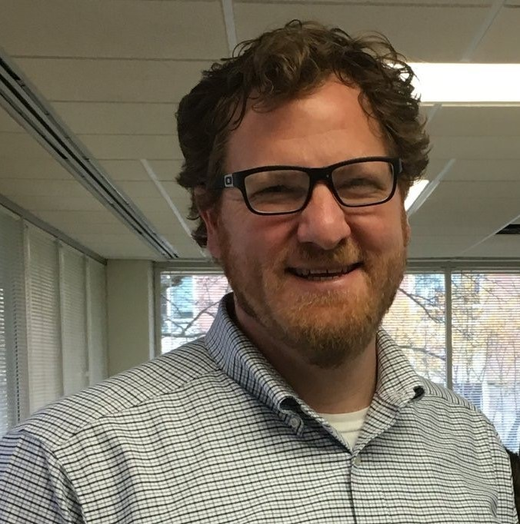
Presenters
Dr. Patrice Ludwig Interim Assistant Vice President, Research, Economic Development & Innovation
James Madison University
Dr. Bill Heinrich Director Mindset by Symplicity
Notes:
justify and fix

Slide 3
Who needs to think about
Assessing Experiential Learning?
Educators & Learners
Instructors/Teachers who engage in a learning process with Learners.
Administrators
Leaders who organize, support, consume, receive, recognize (experiential) learning
Employers
Recruiters of engaged learners with applied and durable skills and domain specific knowledge, skills, and abilities.
YOU
Notes:
We promise to define EL in a few slides.
philosophy
educational approach
program description
data set
external storytelling (reputational)//
internal priority setting -values alignment osmotic filter between external story telling/internal priority setting
(great example of President touting, not telling Provost so he/she can’t prioritize, so then the engineering dept can’t do the work well)

Slide 4
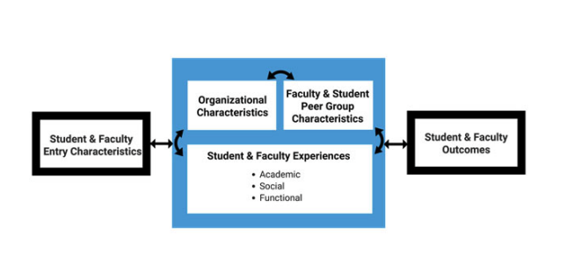
We expect to see interactions at the institutional level.
Selznick, B. S., McCarthy, S., Ludwig, P, Swayne, N., & Lewis, E.J. (2019, August 25 -28). University innovation and innovators: A response-able conceptual model
[Podium presentation]. The Annual Meeting of EAIR: The European HigherEducation Society, Central European University, Leiden, Netherlands.
https://10times.com/european-higher-education-society-forum
Notes:
we should expect these interactions. Now the challenge is about… find a citation.
https://drive.google.com/drive/u/0/my-drive
Selznick, B. S., McCarthy, S., Ludwig, P, Swayne, N., & Lewis, E.J. (2019, August 25 -
28). University innovation and innovators: A response-able conceptual model
[Podium presentation]. The Annual Meeting of EAIR: The European Higher
Education Society, Central European University, Leiden, Netherlands.
https://10times.com/european-higher-education-society-forum

Slide 5
The Challenge
Low Equity
Low Equity
What are the SLOs in Experiential Learning and how do you assess them?
SLOs in EL go beyond content to skills & competencies to include affective, career and engagement outcomes. These areas are not as often considered as part of our work.
Campuses know that HIPs and other EL activities level the playing field of student success, creating equitable learning spaces. These activities also help students develop durable skills like engagement, interpersonal skills, empathy, professional, applied skills, and problem solving.
Holistic SLOs made available to the ecosystem (ie. employers) can improve impacts for students such as recruitment processes. Not attending to holistic outcomes will continue to exclude candidates from minoritized, marginalized, and underserved groups.
Complexity
Low Trust
Green, P., Kolb, A., Kolb, D., & Kuh, G. (2024). Defining Experiential Education. Experiential Learning and Teaching in Higher Education, 7(1).
Notes:
Find EL SLO complexity citation? Patrice

Slide 6
President, Provost
Experiential Learning Ecosystem
VP, AVP, VPSA
Deans, Directors, Chairpersons
Learner/
Educator Interactions
35 types of EL w/ Literatures
Classroom instruction, varies by discipline
First Year Experiences
Learning Communities
Study Abroad
Internships, Co-ops, WBL
Outdoor Pursuits/ Adventure
Student Activities, Clubs, & Orgs
Disciplinary & Professional Practice
Transition & Growth models
Freire's Pedagogy for Citizenship
Intercultural Development
Mentoring & Leadership
John Dewey & Kurt Hahn; Outward Bound
A. Astin’s IEO
Notes:
here are some examples, we counted 35+ types of EL with literatures.

Slide 7
Relevant EL Ecosystem Trends
Pressures on Higher Ed
Students and their Families
Employers
Legislatures
Cost
Public Perception
Emergent EL Offices and Leaders
New-ish Portfolio(s) of EL
Definitions and Taxonomies
Stewarding Campus Priorities
(Executive, Strategic Plans, QEP)
Questions Facing Campus EL
Sustainability
Data
Quality
Recognition
Attention
Notes:
Patrice. emerging from our research.
purpose context

Slide 8
Process Learning Theories (presented chronologically)
See Engeström, Y., & Sannino, A. (2012). Whatever happened to process theories of learning? Learning, Culture and Social Interaction, 1(1), 45–56. https://doi.org/10.1016/j.lcsi.2012. 03.002
Borton’s What, So What, Now What? (1970)
Borton, T. (1970). Reach, touch and teach: Student concerns and education. McGraw-Hill Book Company.
Joplin’s Experiential Learning Model (1981)
Joplin, L. (1981). On defining experiential education.
Journal of Experiential Education, 4(1), 17-20.
Schön’s Reflection in/on Action (1983)
Schön, D. A. (2017). The reflective practitioner: How professionals think in action. Routledge.
Kolb’s Experiential Learning Cycle (1984)
Kolb, D. A. (2014). Experiential learning: Experience as the source of learning and development. FT press.
Gibbs’ Reflective Writing Cycle (1988)
Gibbs, G. (1988). Learning by doing: A guide to teaching and learning methods. Oxford: Oxford Further Education Unit
Kiser’s Integrative processing model (1998)
Kiser, P. M. (1998). The integrative processing model: A frameworks for learning in the field of experience. Human Service Education, 18(1), 3-13.
Rodgers’ Reflective Cycle (2002)
Rodgers, C. R. (2002). Voices inside schools: Seeing student learning. Teacher change and the role of reflection. Harvard Educational Review, 72(2). 230-253.
Moon’s Five Stages of Learning (2004)
Moon, J. (2004) Handbook of Reflective and Experiential Learning: Theory and practice. New York, NY, RoutledgeFalmer
Ash, Clayton & Moses’ DEAL Model (2009)
Ash, S. L., & Clayton, P. H. (2009). Learning through critical reflection: A tutorial for service-learning students. Raleigh, NC: PHC Ventures
Notes:
not an endorsement of kolb, just a high citation count

Slide 9
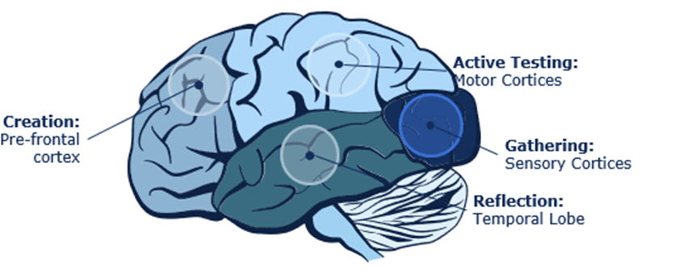
Experiential Learning & Neuroscience
Six Brain-Based Design Principles
Engage the entire learning cycle. Make time for reflection, creation and active testing.
Make a connection with the learner’s prior knowledge and experience.
Create opportunities for social engagement and interaction as part of the learning process.
Engage both feeling and thinking.
Actively attend to attention-gaining, holding, and focusing the learner’s attention.
Engage a maximum number of senses-especially visual-when designing learning. Reflection Activities
Hendel-Giller, R. et al. (May 2010). The neuroscience of learning: A new paradigm for corporate education. A Maritz Institute White Paper. Available at: https://www.maritzmotivation.com/~/media/Files/MaritzInstitute/White-Papers/The-Neuroscience-of-Learning-The-Maritz-Institute.pdf

Slide 10
Experiential Learning Is
Under-Recognized
Concrete Experience
Active
Experimentation
Reflective Observation
Abstract Conceptualization
Where do these durable skills get recognized?
Learning Outcomes, Competency Development
Academic Transcript
Kolb, D. A. (2014). Experiential learning: Experience as the source of learning and development. FT press.
Graduation and
Academic Goals
Notes:
Bill. Process Learning theories.
At the basic level, the dominant education model recognizes only academic outcomes in a grade/transcript
The learning curve of delivering EL includes learning what kinds of assignments and assessments help both students and instructors see the benefits of EL

Slide 11
Assessing EL Directly
Table 1. Summary of Assessment for Integrated Experiential Learning (p.296)
Assessment Approach | Assessment Artifact(s) | Assessed Concepts
Reflective prompts & self- assessments | • Seriated, prompted reflective writing • Self-reporting surveys • Interviews | • Metacognitions, critical thinking, ethical reasoning, differential thinking about one’s own training/discipline, dimensions of learning (Learning Record)
Network participation | • Networks and paths | • Demonstration of individuals working collaboratively across disciplines and problem type
Deliverables | • Tangible product/prototype/solution for client/ partner (e.g., 3D printed items) • Research products (manuscripts, presentations) • Exams | • Design solution for a problem that the student/group identified
How might we assess and recognize the various layers of growth available in Experiential Learning?
Knowledge
Activity
Coordination
Heinrich, W. F., Ludwig, P. M., McCarthy, S., Lewis, E. J., Swayne, N., & Louson, E. L. (2021). Testing assessments of integrated experiential learning. In Adam Peck and Danielle DeSawal (Eds.) Applying design thinking to the measurement of experiential learning. United, States. IGI Global Publishing.
Notes:
When we look closely
Directly assessing
co-evoluiton of Xlabs
how did we land on reflective prompts (cross disciplines).

Slide 12
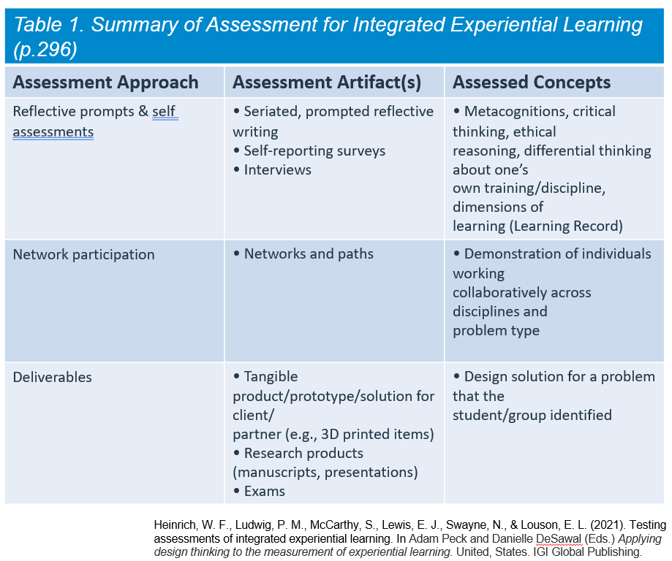
Assessing EL: Evaluating Experiences
How might we assess and recognize the various layers of growth available in the idea of Experiential Learning?
Knowledge
Activity
Coordination
(via Logic Model)
People | Activities | Resources | Output | Outcome | Impact
Educators | Experiential Learning | ?? | Engagement | Purpose | Belonging
Finley, A. (2019). A Comprehensive Approach to Assessment of High-Impact Practices. Occasional Paper No. 41. National Institute for Learning Outcomes Assessment.
Notes:
At the activity…
set up for rings. bridge to rings.
bridge between doing interesting teaching and having the instution caring about it.

Slide 13
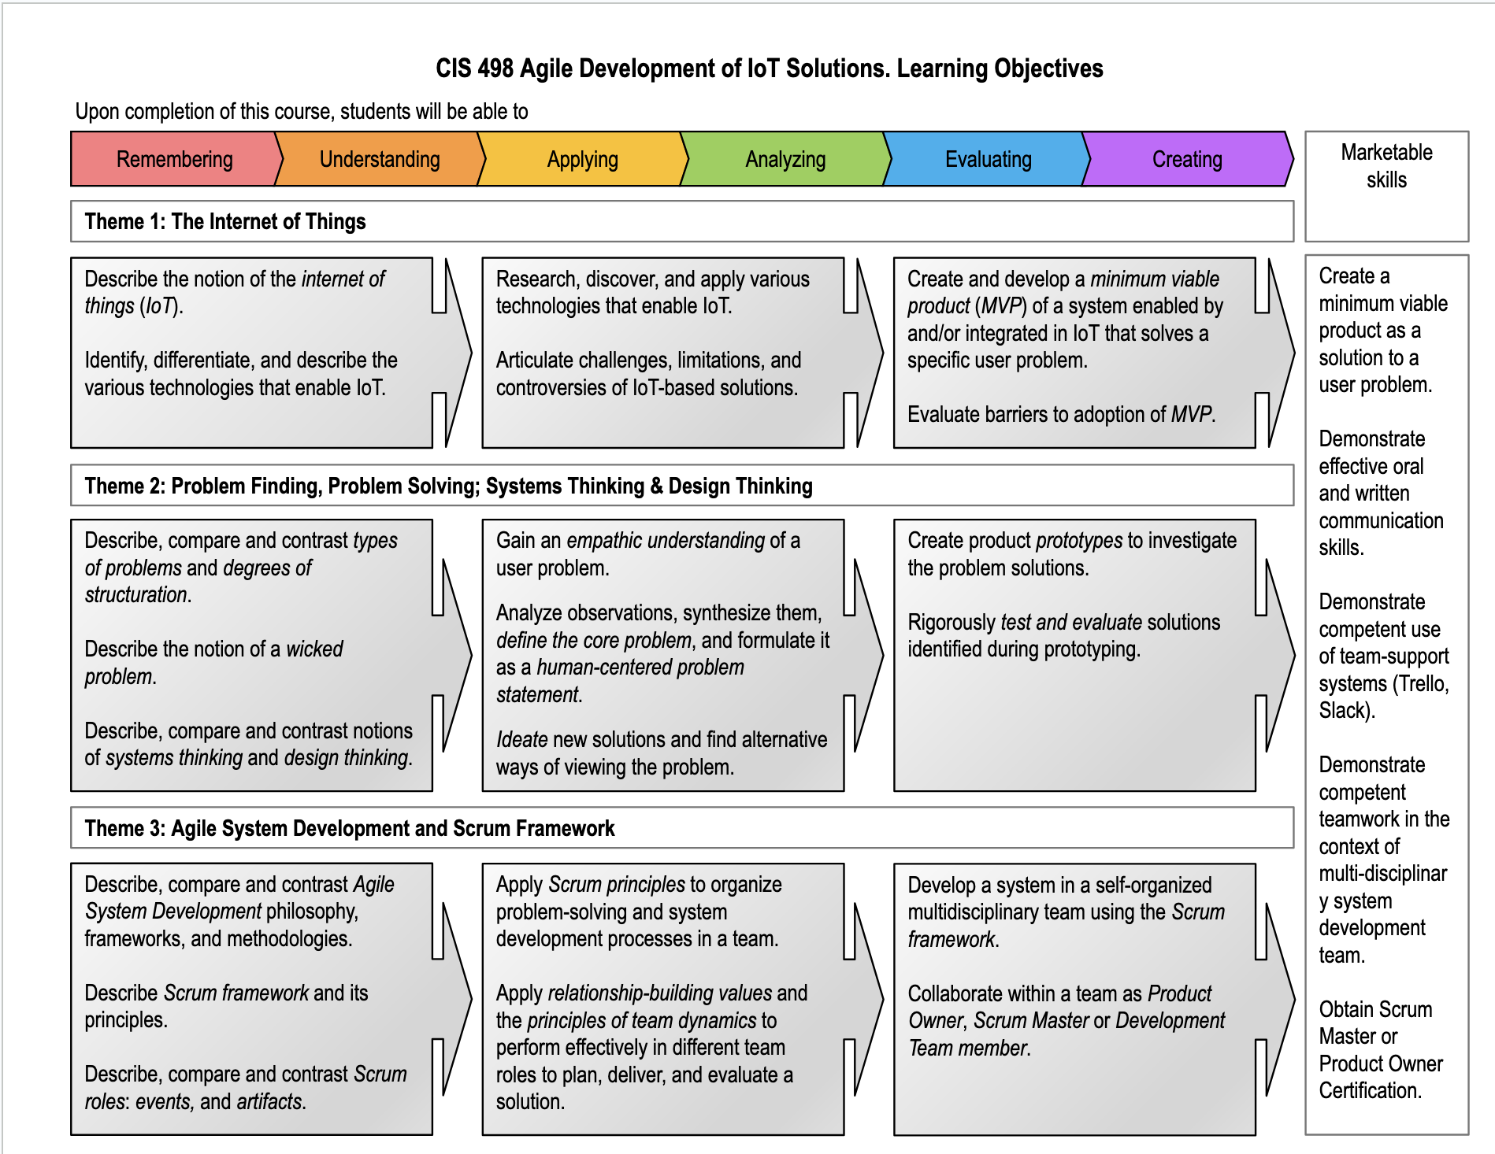
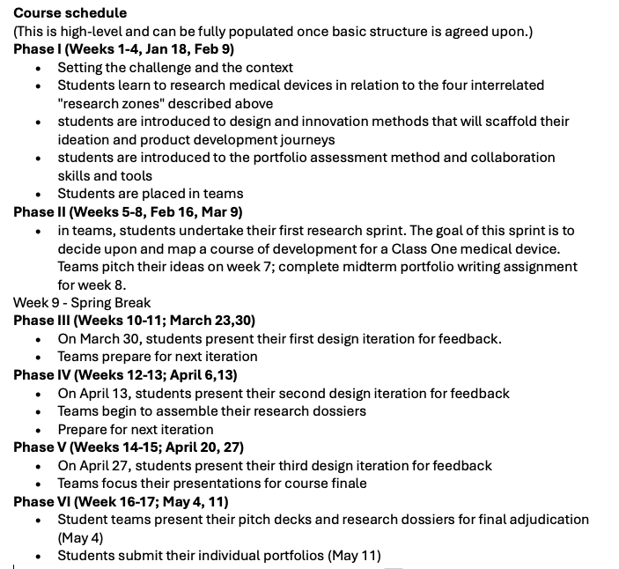
course planning template
Delivering EL in a course.
X-Labs Medical Innovations
Dr. Dmytro Babik in X-Labs Internet of Things
Notes:
Xlabs manual - pull this, picture. Patrice

Slide 14
Experiential Learning provides multiple opportunities to assess learning in different domains
Retention and Student Success
Institutional Priority
Engagement, Purpose, Belonging
Learner Impact
Concrete Experience
Empathy, Self-awareness, Emotional intelligence
Holistic
Student
Development
Work Readiness, Applied Skills in a field.
Active
Experimentation
Reflective Observation
Career
Readiness
Kolb, 2014
Abstract Conceptualization
Learning Outcomes, Competency Development
Arrows represent data alignments and cross walks from courses to learners to institution.
Graduation and
Academic Goals
Heinrich, B., Hough, T., Lewis, E. J., Louson, E., Ludwig, P. M. McCarthy, S., Swayne, D. & Titareva, T. (2024). Experiential Learning Ecosystems. Presented at SLO Talks, Mindset by Symplicity.
Notes:
Bill. Assessment model.
1. We have to know where to look, what to look for, and what to do with it.

Slide 15
Where to
Recognize EL
Unit reports, IR
Engagement, Purpose, Belonging
How might we recognize the various layers of growth available in the idea of Experiential Learning?
Learner Impact
Concrete Experience
Work Readiness, Applied Skills in a field.
Active
Experimentation
Reflective Observation
Empathy, Self-awareness, Emotional intelligence
Kolb, 2014
Abstract Conceptualization
CCR
Learning Outcomes, Competency Development
SER
Capstone
Transcript
LER
Notes:
constant reminder not just in AA.
Blue oval = Better data :)

Slide 16
Discussion
How does your role and point of view influence your view of Experiential Learning on your campus?
What Experiential Learning outcomes
are you assessing and how?

Slide 17
Acknowledgments
Research and analyses on the Experiential Learning Ecosystem is an ongoing project with contributions from the following investigators (listed alphabetically):
Bill Heinrich, Mindset by Symplicity
Tyler Hough, The Chicago Center
Erica J. Lewis, James Madison University
Eleanor Louson, Michigan State University
Patrice M. Ludwig, James Madison University
Sean McCarthy, James Madison University
Nick Swayne, North Idaho College
Tatjana Titareva, James Madison University
Thanks to Cam Ballantyne at Symplicity for insights on LER ecosystems

Slide 18
Questions?
Thank you for joining us!
Bill Heinrich: bheinrich@symplicity.com
Patrice Ludwig: ludwigpm@jmu.edu

Slide 19
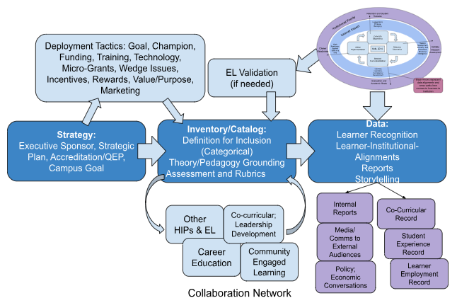
Operationalizing Experiential education for Institutional Success Panelists: Abby Baker, Carolyn Roberts, Emily Carpenter, Tabitha Fedina Moderator: Bill Heinrich SEE Conference, 2024
Heinrich, B., Hough, T., Lewis, E. J., Louson, E., Ludwig, P. M.
McCarthy, S., Swayne, D. & Titareva, T. (2024).Collaboration Network: Leading in Experiential Learning Ecosystems.

