Slide 1
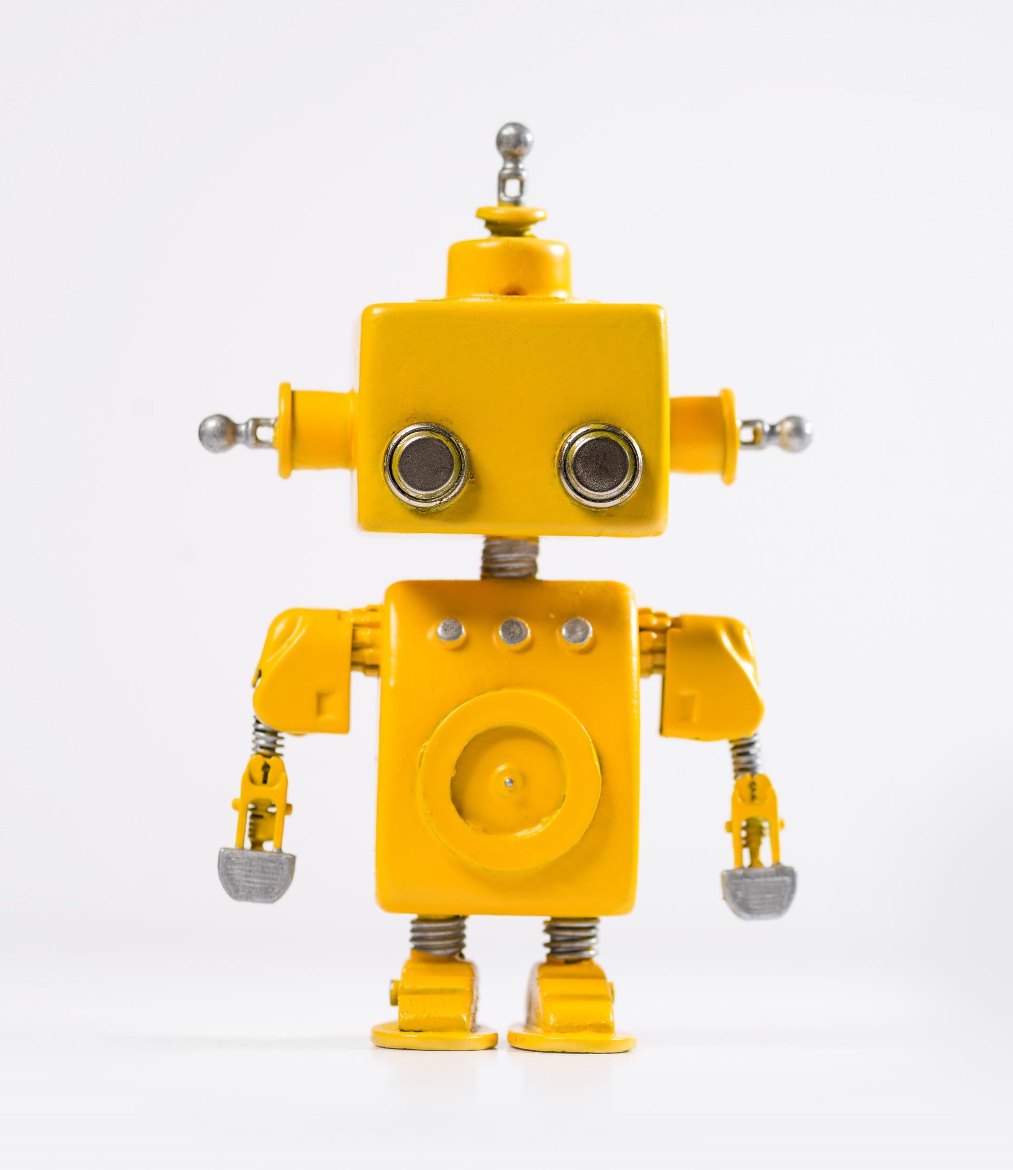
How to analyze Canvas Outcomes & Assessment Data Efficiently Using GPT-4 Artificial Intelligence Application
Kristen Linton, MSW, Ph.D.
Academic Assessment Director & Associate Professor of Health Sciences
California State University Channel Islands

Slide 2
Write this in the chat. What amount of your faculty struggle with any of the following… Just a few, some, or most?
Data analysis?
Data analysis tools?
Understanding data?
Paying for data analysis help?

Slide 3
What if…
Faculty could show the data to someone, chat with them in their own language, and tell them what they want to learn from the data?
This other person suggests & conducts analyses and addresses issues with the data, such as combining data, replication or measurements not measured the same way over time? They even provide a summary of the results.

Slide 4
Until now…
That person was most likely US.

Slide 5
From now on…
It could be Artificial Intelligence, specifically today GPT-4.
“Hi, I’m, GPT-4. How can I help you?”

Slide 6
Today we will discuss Canvas Outcomes data, but
Any data in a spreadsheet format is relevant to today’s presentation.
I have asked GPT-4 to analyze paired-samples longitudinal data in separate datasets per data collection time point, it combined the data, matched the participants based on ID, and analyzed the data.

Slide 7
Canvas Outcomes
A tool within the Canvas LMS that allows for ease of program assessment data collection across course section, semester, and years
Canvas Outcomes rubrics are developed by faculty & then used in used in multiple course sections by various instructors in various semesters and years
Canvas Outcomes data can be downloaded into spreadsheets

Slide 8
GPT-4
A large language model that can read and process uploaded spreadsheets of data and has data analysis capabilities
Python coding capabilities are used for most data analysis functions
Paid service $20/month for personal account (only use deidentified data)- $25/month for professional account that enables private information

Slide 9
Step #1 Download Canvas Outcome Data from Canvas

Slide 10
STEP #2 UPLOAD DATASET INTO GPT-4 WITH A PROMPT such as this...BE SPECIFIC
Use

Slide 11
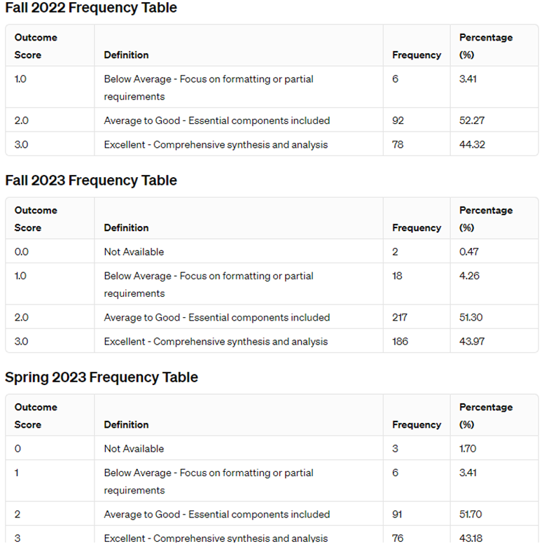
STEP #3 VIEW RESPONSE

Slide 12
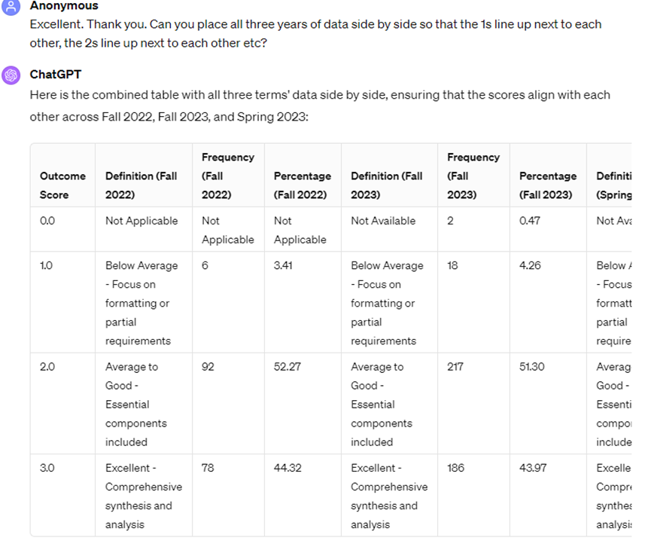
STEP #4 GIVE FEEDBACK/REVISION PROMPT

Slide 13
STEP #5 ASK FOR A SUMMARY REPORT

Slide 14
GPT-4 isn’t the only AI that can do this…
Narrativa AI has a $5 pay per use/report model- could be cheaper than GPT-4; analyzes live dataset in Google Docs (for example)

Slide 15
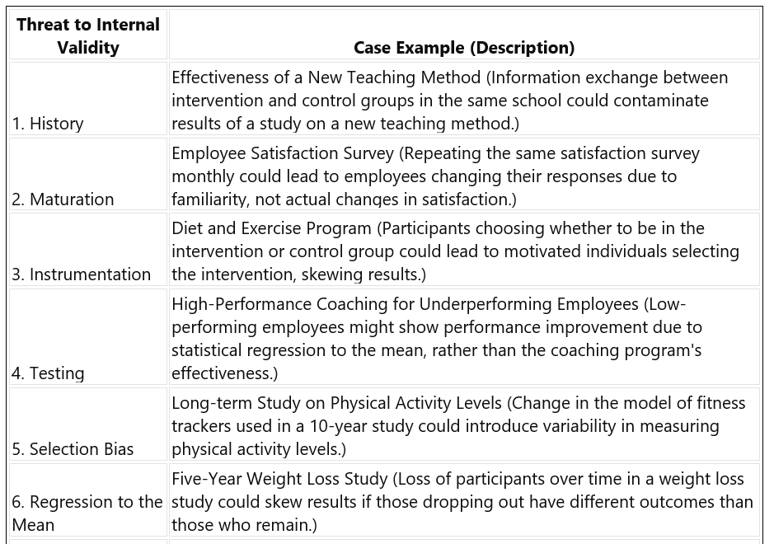
Bonus: How I’ve integrated (ChatGPT) into my teaching this semester
Idea creation
Students checking their own work
Gamification of learning

Slide 16
THANK YOU & I TRULY HOPE YOU ENJOY EFFIFICIENT DATA ANALYSIS & REPORTING OF ASSESSMENT DATA Kristen.linton@csuci.edu

