Slide 1
How Learning Works
Dr. Susan A. Ambrose
Happily Retired Professor & Administrator
Carnegie Mellon University (31 years)
Northeastern University (8 years)
March 15, 2024

Slide 2
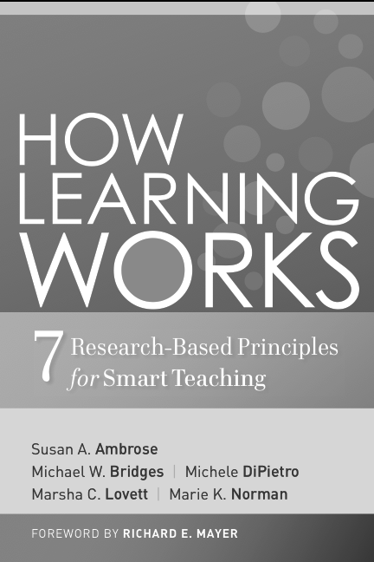
Agenda
I. Briefly set the context for “learner-centered” teaching
II. Briefly present a few of the 7 principles of learning that can be used in the design of courses, classroom pedagogy and learning experiences, stopping periodically for questions, comments, examples of the principles in action, concerns, etc.

Slide 3
Objective for the Session
By the end of this session, participants should be able to
Describe at least 1 of the principles to a colleague who hasn’t attended this session and explain how you already use or plan to use the principle in a course you teach.

Slide 4
The Context

Slide 5
Our 7 Principles of Learning are
Grounded in
Research literature
Work with faculty
Broadly applicable, across
Domains, Students (ages, levels), and Contexts
Generative
Help faculty devise or use effective teaching strategies that are appropriate to a particular situation

Slide 6
Why a “learner-centered” approach?
Learning results from what the student does and thinks and only from what the student does and thinks. The teacher can advance learning only by influencing what the student does to learn.
Herb Simon (2001)
For me, learning is the ability to use information and skills fluently and flexibly in new contexts.

Slide 7
When we focus on the learner, we consider…
The learner’s
Prior knowledge
Life experiences
Values, attitudes, beliefs
Goals
Influence her
Interpretation of information
Retrieval of knowledge
Organization of new information
Synthesis and application of new knowledge
Expectations
Adjustment to new situations

Slide 8
This shifts the perspective…
From
How do we teach?
to
How do students learn?

Slide 10
The Principles at a Glance
Students’ prior knowledge can help or hinder learning.
How students organize knowledge influences how they learn and apply what they know.
Students’ motivation determines, directs, and sustains what they do to learn.
To develop mastery, students must acquire component skills, practice integrating them, and know when to apply them.
Goal-directed practice coupled with targeted feedback enhances the quality of students’ learning.
Students’ current level of development interacts with the social, emotional, and intellectual climate of the course to impact learning.
To become self-directed learners, students must learn to monitor and adjust their approaches to learning.

Slide 11
1. Students’ prior knowledge can help or hinder learning.

Slide 12
“It’s not what we don’t know that gives us trouble. It’s what we know that ain’t so.”
Will Rogers

Slide 13
2. How students organize knowledge influences how they learn and apply what they know.

Slide 14
Knowledge organizations vary in how individual pieces of knowledge are related.

Slide 15
3. Students’ motivation determines, directs, and sustains what they do to learn.

Slide 16
Motivation will be enhanced if. . .
Students believe they have a reasonable expectation of attaining success.
Students perceive the value (relevance, importance, utility) of a particular task or goal.
Motivation is all about perception.

Slide 17
4. Goal-directed practice coupled with targeted feedback enhances the quality of students’ learning.

Slide 18
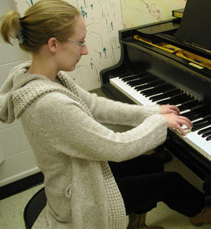
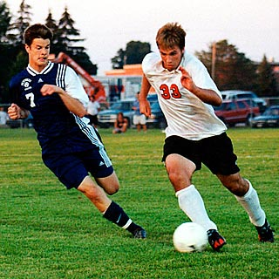
Does “practice make perfect”?
Think about practice in the context of sports or music: Is it sufficient to tell students “just play”?

Slide 19
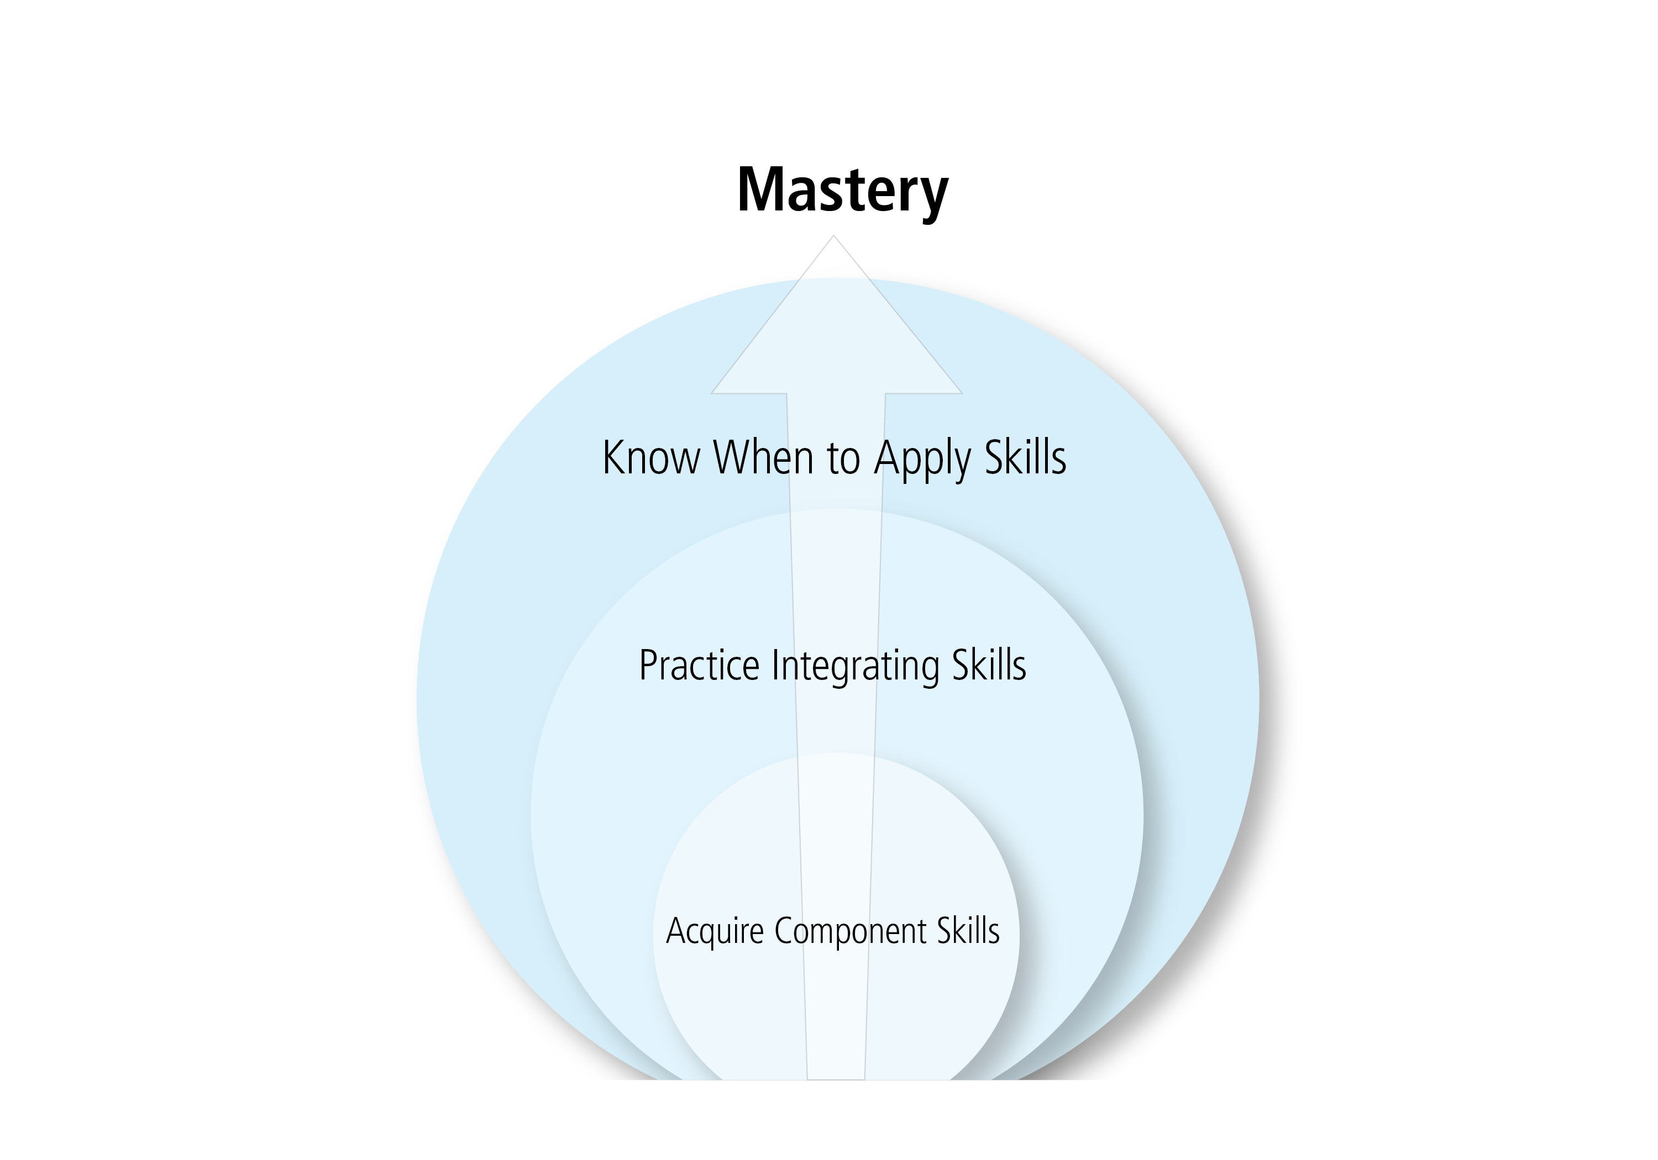
5. To develop mastery, students must acquire component skills, practice integrating them, and know when to apply them.

Slide 20
As mastery develops and students gradually gain competence within a domain, they first gain and then lose conscious awareness of the skills and capabilities they are exercising.
(Sprague & Stuart 2000)

Slide 21
6. Students’ current level of development interacts with the social, emotional, and intellectual climate of the course to impact learning.

Slide 22
Why care about student development and climate?
We teach students, not just content!

Slide 23
7. To become self-directed learners, students must learn to monitor and adjust their approaches to learning.

Slide 24
Why is this important?
Most students do not naturally engage metacognitive skills or self-directed learning strategies.
As instructors, we can support students in developing these skills and making them habits of mind.
Doing so can pay big dividends for students’ life-long learning.

Slide 25
Recap of the Principles
Students’ prior knowledge can help or hinder learning.
How students organize knowledge influences how they learn and apply what they know.
Students’ motivation determines, directs, and sustains what they do to learn.
To develop mastery, students must acquire component skills, practice integrating them, and know when to apply them.
Goal-directed practice coupled with targeted feedback enhances the quality of students’ learning.
Students’ current level of development interacts with the social, emotional, and intellectual climate of the course to impact learning.
To become self-directed learners, students must learn to monitor and adjust their approaches to learning.

Slide 26
Remember that . . .
Teachers possess the power to create conditions that can help students learn a great deal – or keep them from learning much at all. Teaching is the intentional act of creating such conditions.
– Parker Palmer, The Courage to Teach

