Slide 1
Guide to SLO Assessment and Artificial Intelligence Coordinators’ Training September 22, 2023
• Alisha Bettencourt, Ph. D.
Faculty Assessment Coordinator, San Diego Community College District
• Michele Dunbar, Ph.D.
Office of the Provost at California State University, Dominguez Hills.
• Jarek Janio, Ph.D.
Faculty Coordinator, Santa Ana College School of Continuing Education
• Enrique Jauregui, SLO Coordinator at Fresno City College.
• Patricia Manley, Outcomes Assessment Facilitator,
San Diego Miramar College
• Benny Ng, Outcomes Coordinator, Los Angeles Pierce College
• Liza Rabinovich, Faculty Outcomes Coordinator, San Diego Mesa College
• Amanda Taintor Faculty ID and Outcomes Coordinator, Reedley College.
• Bethany Tasaka, Interim Dean of Mathematics, Business, and Computer Technology Division at San Bernardino Valley College.
• Trisha Wilging SLO Coordinator, Long Beach City College.

Slide 2
First words …
We aim to provide faculty and educational leaders with a comprehensive guide to effectively implement Student Learning Outcomes (SLOs) in courses, programs, and institutions. SLOs are described as key descriptors of observable student behavior resulting from the acquisition of theoretical knowledge, emphasizing the importance of clearly communicating these outcomes to students.
By shifting the focus from grading compliance to skill and competency acquisition, SLO assessment becomes a valuable tool for improving instruction and learning, fostering accountability driven by students' ability to demonstrate what they have learned.
These notions have been unexpectedly and immensely impacted by Artificial Intelligence in general and Chat GPT in particular.

Slide 3
Guide to Student Learning Assessment
Step 1: Course Content Analysis
Step 2: SLO Statement Design
Step 3: SLO Alignment to Program and Institution SLOs
Step 4: Direct Assessment Rubric Design
Step 5: SLO Assessment Data Analysis
Step 6: Closing of the Assessment Loop
Guide to Student Learning Assessment

Slide 4
Step 1: Course Content Analysis How can Chat GPT Facilitate the Process?
What is the course outline of record?
The official Course Outline of Record (COR) defines the content, objectives, methods of instruction and evaluation, sample textbooks and instructional materials for the course, and more.
Content Review and Alignment
Objective/SLO Statement Generation
Documentation and Reporting (Curriculum)
Training and Support
Consistency and Standardization
Syllabus development
While ChatGPT can be a valuable tool in the SLO assessment process, it's important to note that it should complement, rather than replace, the expertise and judgment of faculty members. Faculty input and knowledge of their subject matter remain essential for the development of meaningful SLOs that align with the course content and instructional goals. ChatGPT can enhance efficiency and provide support, but human judgment and expertise should always guide the process.

Slide 5
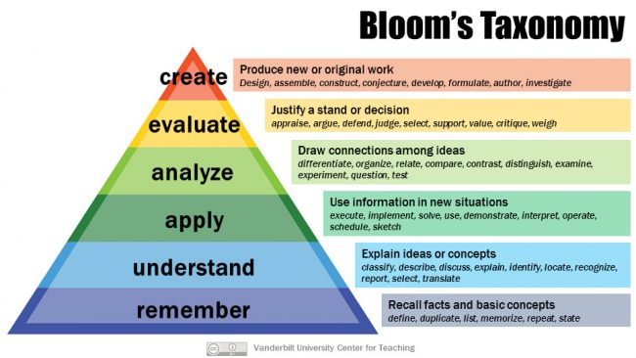
Step 2: SLO Statement Design
Verb Selection and Alignment
SLO Statement Generation
Feedback and Refinement
Alignment Check
Consistency and Standardization

Slide 6
Step 3: SLO Alignment to Program and Institution SLOs
Alignment Guidance
Documentation and Tracking
Cross-Disciplinary Alignment
Consistency Across Disciplines
Mission and Vision Alignment
Promoting Continuous Improvement (course, program, institution)

Slide 7
Step 4: Direct Assessment Rubric Design
Rubric Development Assistance
Alignment Verification
Rubric Consistency
Examples of Scenarios and Real Life Situations
Interdisciplinary Insights
Documentation Guidance
Direct Evidence Emphasis
Employability Focus

Slide 8
Step 5: SLO Assessment Data Analysis
Data Processing Assistance
Data Analysis Techniques
Identification of Improvement Areas
Continuous Improvement Emphasis
Data Visualization
Cross-Level Analysis
Communication of Results
Student Engagement

Slide 9
Step 6: Closing of the Assessment Loop
Action Research Process
Resource Request Guidance
Intervention Strategies
Analysis of Commitments
Documentation and Reporting
Emphasis on Direct Evidence
Employability Focus

Slide 10
https://coaches.institute/
Contact: info@coaches.institute

