Slide 1
Friday SLO Talks
Six Steps for SLO Implementation

Slide 2
Step 5: Data Analysis
Last year, LBCC was in our “assessment” year within our SLO Cycle. We focused a lot on developing/building robust assessments to obtain instructionally meaningful results.
All results of assessment are collected on Canvas.
Two years ago, and again this year, visualized results data (in Tableau) allow our faculty to see areas of student weakness and strength.
Analysis of that data (especially in faculty inquiry group discussions) allows stakeholders to determine why these areas exist and to begin to converse about how to address weaknesses and leverage strengths.

Slide 3
Step 5: Data Analysis
We have discovered that analysis is more enterable with the “Analysis and Action Guide Worksheet,” which is provided for work with all the College’s SLO results data.
At the course-level and program-level, analysis is conducted by faculty who teach the courses/in the programs.
At the institution level, analysis is conducted by the College’s Assessment of Student Learning Outcomes Subcommittee (composed of faculty, staff, and administrators).

Slide 4
READ 82: Quiz-Based Assessment
A reading selection is provided to students.
The passage is current and relevant.
Students have adequate prior knowledge to approach the assessment confidently.
15 questions are asked about the passage.
Questions call for the demonstration of student skills in an authentic task
Questions are asked from varied angles.
Questions allow students multiple opportunities to demonstrate understandings.

Slide 5
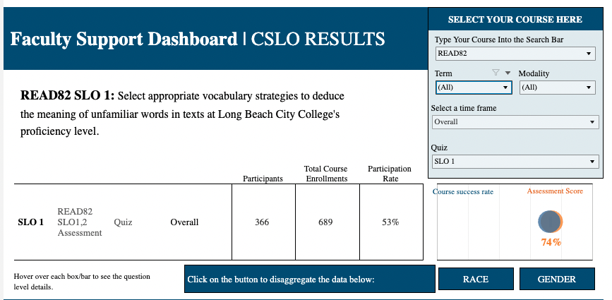
CSLO Tableau Dashboard
Quiz-question level results
Participation Rate
Comparison between course success rate and average assessment score

Slide 6
CSLO Tableau Dashboard – Quiz Disaggregation
Gender
Race/
Ethnicity

Slide 7
EDUC 20: Rubric-Based Assessment

Slide 8
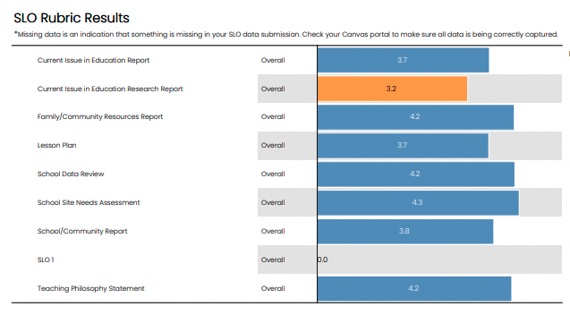
CSLO Tableau Dashboard
Rubric-category level results
Participation Rate
Comparison between course success rate and average assessment score

Slide 9
CSLO Tableau Dashboard – Rubric Disaggregation
Gender
Race/
Ethnicity

Slide 10
CSLO Analysis & Action Guide

Slide 11
PSLO Tableau Dashboard

Slide 12
PSLO Tableau Dashboard
Aggregate PSLO Assessment Scores

Slide 13
PSLO Tableau Dashboard – with CSLO to PSLO mapping
PSLO1
All mapped CSLOs
PSLO2
All mapped CSLOs
PSLO3
All mapped CSLOs

Slide 14
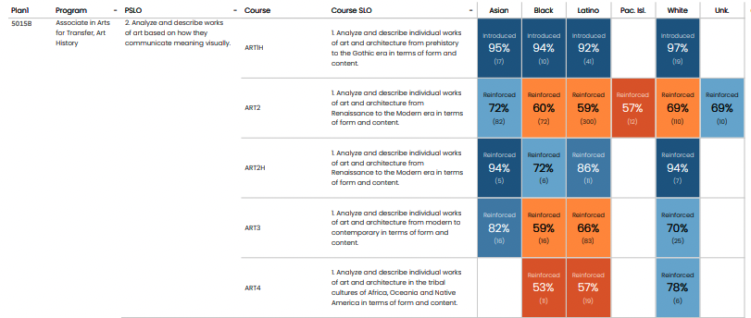
PSLO Tableau Dashboard – with CSLO to PSLO mapping & disaggregation
PSLO2 by race/ethnicity
PSLO3 by gender

Slide 15
PSLO Analysis & Action Guide

Slide 16
ISLO Tableau Dashboard
Participants
Average assessment score
Rubric results
by unit completion

Slide 17
ISLO Tableau Dashboard - Disaggregation
Race/Ethnicity
Gender

Slide 18
ISLO Analysis & Action Guide

Slide 19
Questions?
Trisha Wilging
SLO Coordinator – Long Beach City College
https://www.lbcc.edu/student-learning-outcomes
twilging@lbcc.edu

