Slide 1
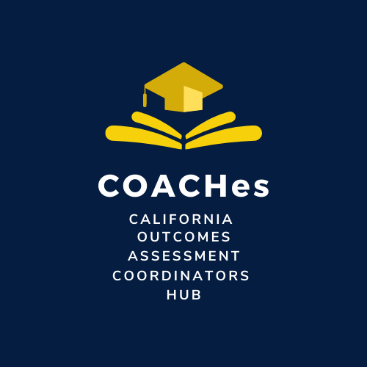
Friday SLO Talks
Six Steps for SLO Implementation
Notes:
Hello, I am Shannon Jessen, biology professor and Faculty Tri Chair for Chaffey College’s Outcomes & Assessment Committee.

Slide 2
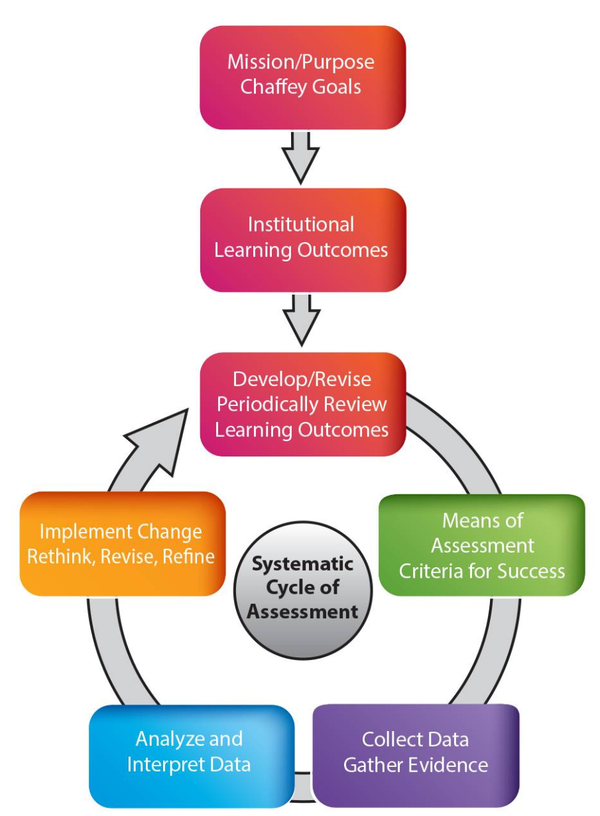
Curriculum to Career:
Alignment of Course, Program, and Institutional Learning Outcomes

Slide 3
Overview of “alignment”
Institutional Learning Outcomes
All learning outcomes are “student learning outcomes” (SLOs)
Direct assessment occurs at the course level, but need not be restricted to course SLOs
Intentional alignment enables direct assessment of Program and/or Institutional LOs
Program Learning Outcomes
Course
Learning Outcomes
Course
Objectives

Slide 4
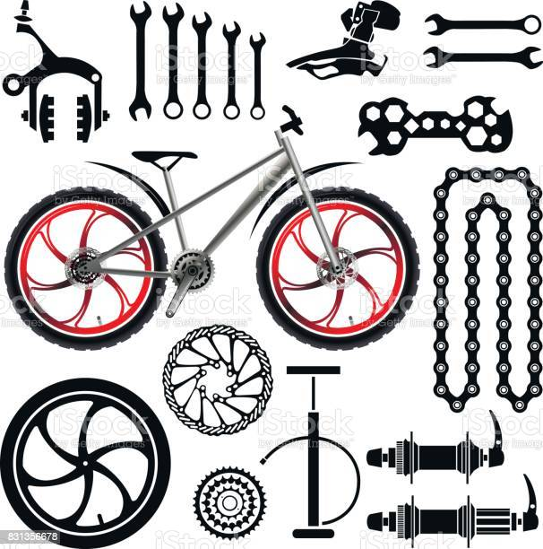
Defining the levels
Institutional LOs: broad competencies common to all programs of study
Program LOs: specific skills and competencies acquired through completion of a series of courses
Course LOs: a focused set of knowledge, skills, and abilities acquired through completion of activities and assessments

Slide 5
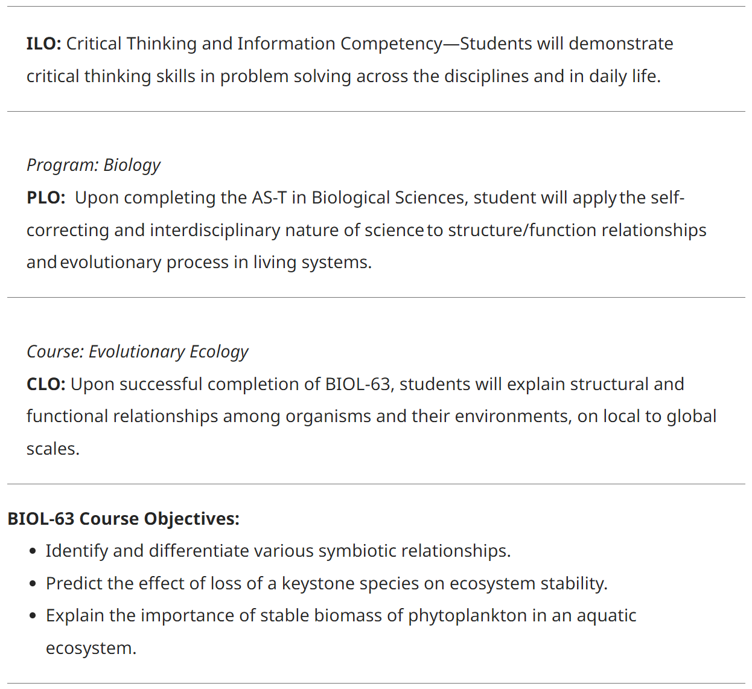
Alignment Example from Chaffey College
Sample assessment question!

Slide 6
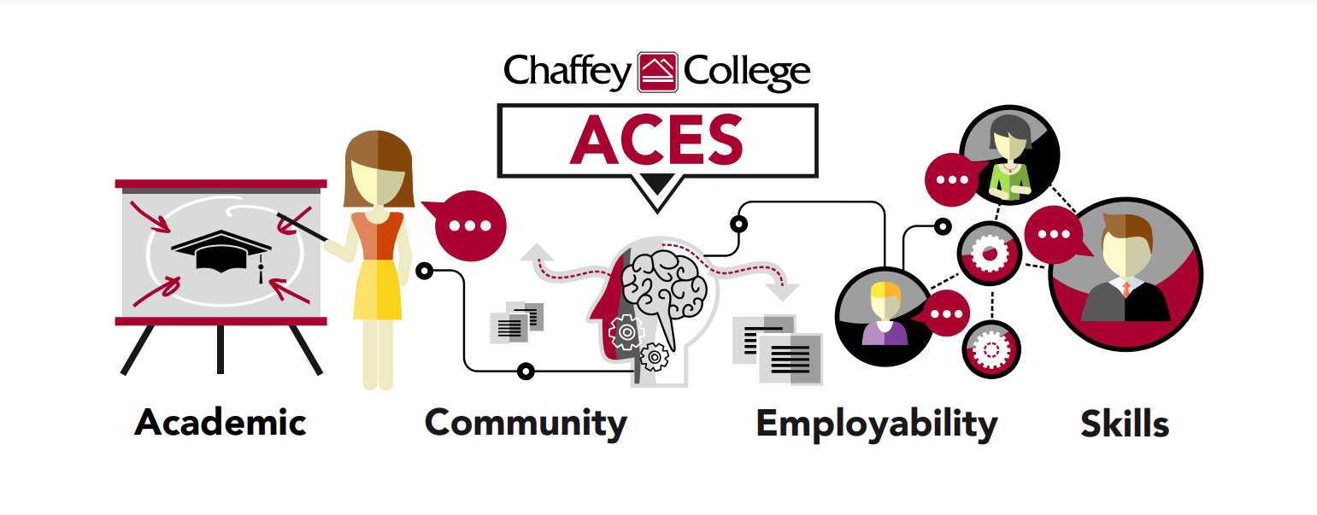
Curriculum to Career: ACES
Intentional alignment of Course, Program, and Institutional LOs
Emphasis on skills valued by employers and programs of study
Students: earn digital microcredentials via Career Center and communicate purpose & outcomes of assignments
Faculty: streamlined SLO assessment, data management, and closing the loop
Employers: certification of specific skills by discipline experts “beyond grades”

Slide 7
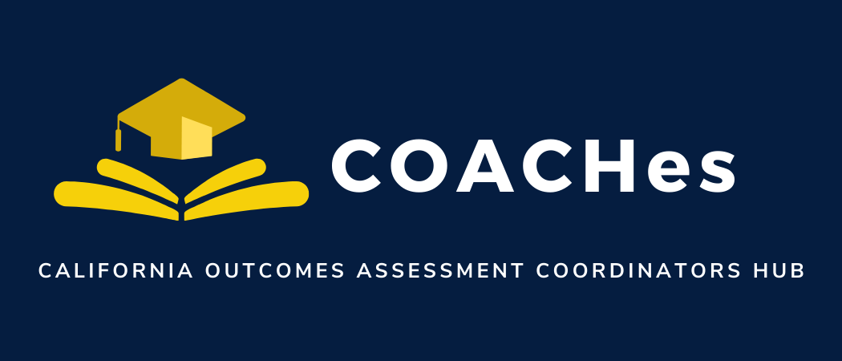
Questions?

