Slide 1
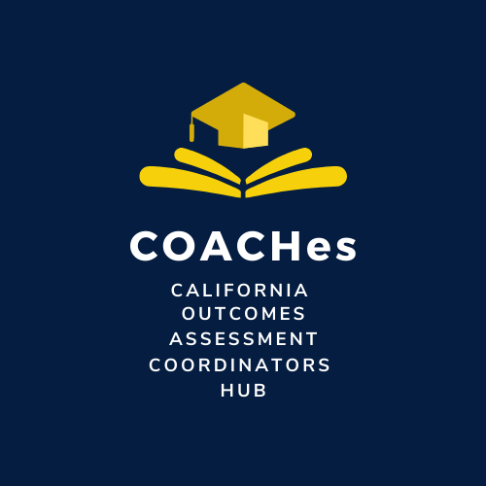
Friday SLO Talks
Six Steps for SLO Implementation

Slide 2
“Therefore, if SLOs originate with the course content, what are faculty teaching if not SLOs?”
-Guide to Student Learning Assessment

Slide 3
Step 1: Course Content Analysis, Curriculum, & Syllabus
Bethany Tasaka
San Bernardino Valley College
Curriculum Chair/Outcomes Faculty Lead

Slide 4
Guiding Question: Why Start with Course Content?
Courses have two distinct outcomes or competencies:
Theory
Practice
We need to assess outcomes so that students and faculty know
Students’ mastery of theoretical concepts
How well they can put them into practice
A grade of B+, for example, does not say to what extent the student acquired one or the other of the two outcomes.

Slide 5
Course Content Analysis, Curriculum, & Syllabus
Student Learning Outcomes (SLOs) originate with Course Outline of Record (COR).
Or a similar, official publication, as a document that specifies course content.
Faculty intend for students to learn course content.
How do we know what they learned?
SLO development begins with a thorough and detailed analysis of concepts, skills, and competencies that students are expected to learn.
The COR outlines this content.

Slide 6
Course Content Analysis, Curriculum, & Syllabus
This is a faculty-driven process.
Identify the overarching concepts for the given course.
Describe skills and competencies that students are going to learn.
The focus is on what students learn, rather than on what the course offers or even what faculty want to present, discuss, or “cover” in the course.

Slide 7
Course Content Analysis, Curriculum, & Syllabus
The language describing what students learn must be very specific, clearly indicating what students will be able to do because of instruction.
This is very important for equity conversations.
Students need to be informed about what skills and competencies they are going to be expected to acquire and demonstrate in the course from the very beginning.

Slide 8
Course Content Analysis, Curriculum, & Syllabus
Once the overarching outcomes are identified, recognize the smaller steps that lead to student attainment of those skills and competencies.
These smaller steps are normally referred to as course objectives.

Slide 9
Course Content Analysis, Curriculum, & Syllabus
At the end of the analysis of the course subject matter, faculty generate a list of outcomes and objectives encompassing the entire course content.
Once this task is finished, the question of how many outcomes in the course are required goes away, because outcomes and the objectives leading to them represent the entire course content.
When faculty teach course content, they ensure that students are learning skills and competencies as outlined in the COR.

Slide 10
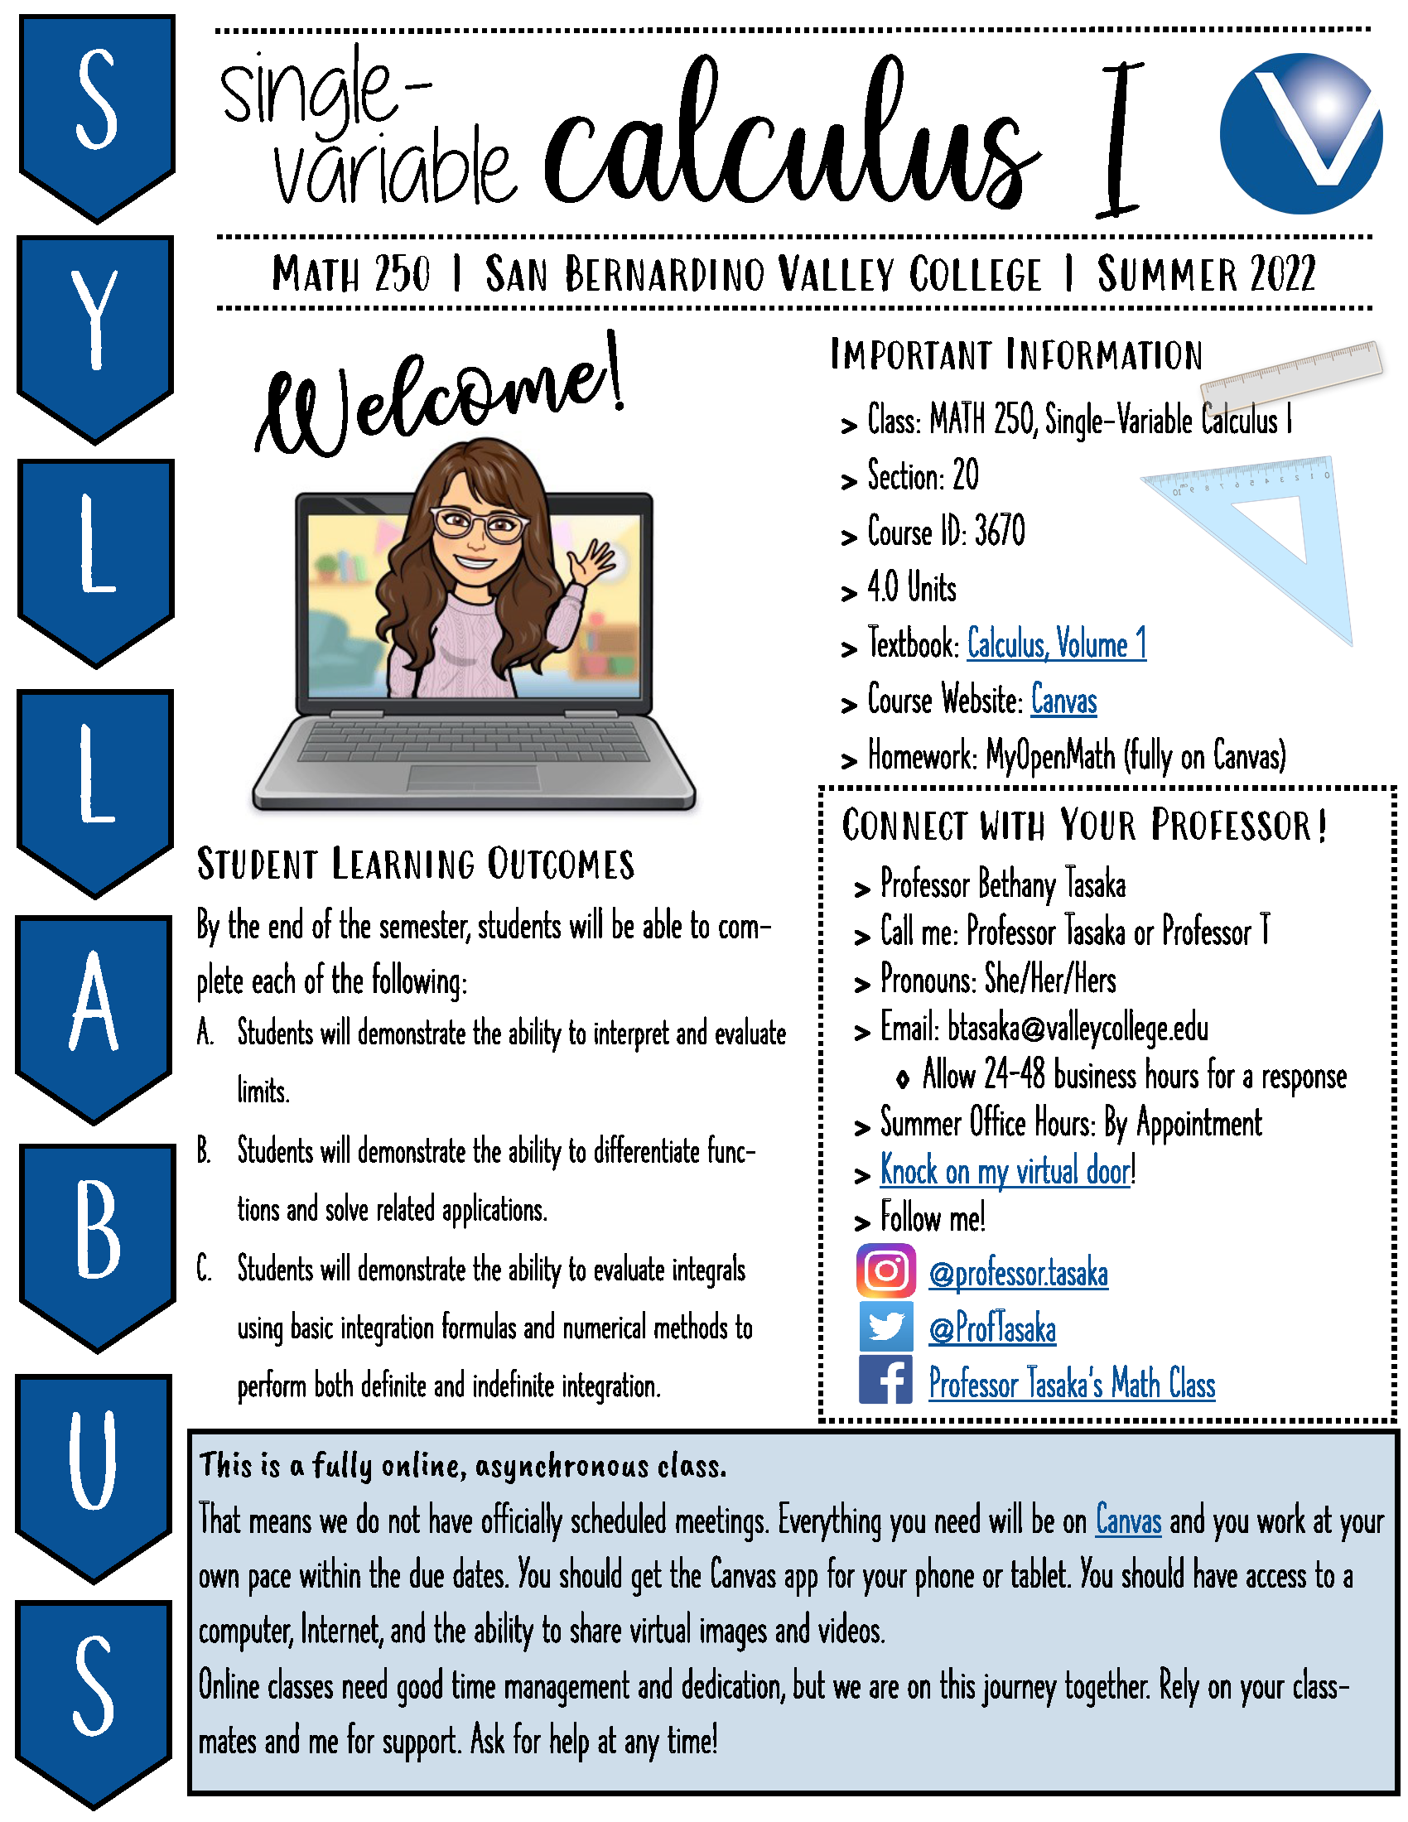
Recommendations
Work with your department and Curriculum Committee.
Hold these conversations.
Discuss best practices.
This is not an isolated process.
Put course outcomes on the front of your syllabi.

Slide 11
Questions?
Contact:
Bethany Tasaka
btasaka@valleycollege.edu

