Slide 1
Keeping track of student learning
Jarek Janio, ph.d.
SLO coordinator, santa ana college

Slide 2
Six Steps for SLO Implementation
STEP one: course content analysis
STEP two: slo statement design
STEP three: slo alignment to program and institution learning outcomes
STEP four: direct assessment rubric design
STEP five: slo assessment data analysis
STEP six: closing of the loop

Slide 3
Course Outline of Record
STEP ONE: COURSE CONTENT ANALYSIS

Slide 4
Course Outline of Record
ASCCC Publication p. 12 p. 21-23 Course ID
Course Outline of Record at the college level
Examples of databases where these documents are kept
What’s the approval process? Who is responsible? The gatekeeper?

Slide 5
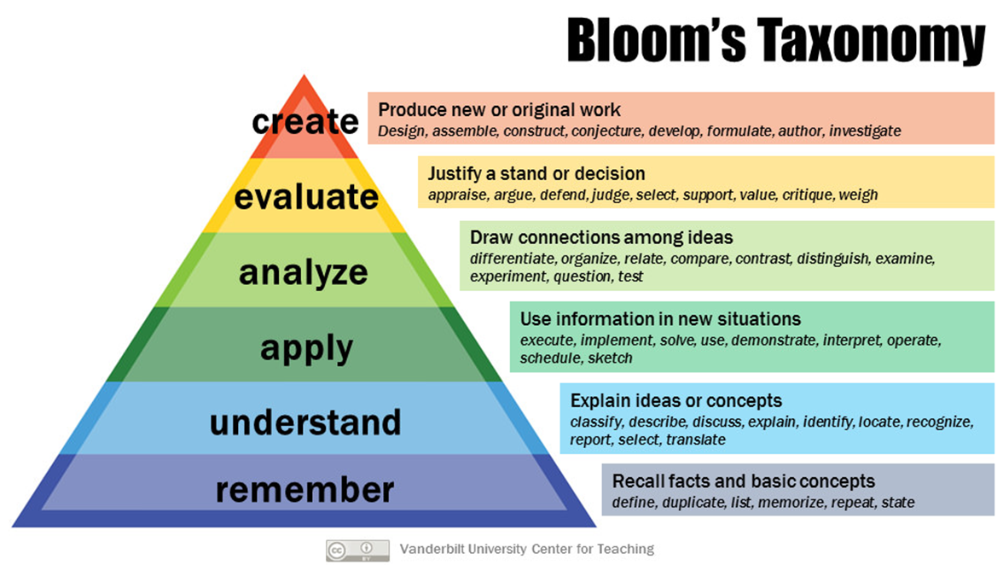
STEP two: slo statement design

Slide 6
Bloom’s Taxonomy
Student Learning Outcomes
use knowledge of the components of argument, rhetorical devices, and logical fallacies to respond critically to various texts.
formulate sophisticated arguments and defend them with logical, persuasive evidence.
demonstrate proficiency in using standard written English.
demonstrate proficiency in integrating and documenting appropriately-chosen sources, in MLA format, or when appropriate in APA format, in an academic research essay.
ENGL 103 – Critical Thinking and Writing
How many SLOs? PLOs? ILOs?
How many times to assess SLOs? PLOs? ILOs?
Where are these housed?
Where are these edited?
Who is responsible?

Slide 7
SLOS TO PLOS TO ILOS
STEP three: slo alignment to program and institution learning outcomes

Slide 8
Mapping
Student Learning Outcomes (SLOs) are skills and competencies acquired by students in courses.
Program Learning Outcomes (PLOs) are skills and competencies acquired by students in programs. These may come from a variety of documents that provide specific guidelines from outside of our institutions.
Institutional level outcomes (ILOs) need to be aligned with institution’s mission and vision statements. ILOs are usually broader competencies such as: critical thinking, leadership, problem solving, or communication skills and they can be found in subject matter of any discipline and should be of interest to all stakeholders throughout the institution.
How can this be done electronically?
Who is responsible for quality?

Slide 9
A rubric is typically an evaluation tool or set of guidelines used to promote the consistent application of learning expectations, learning objectives, or learning standards in the classroom, or to measure their attainment against a consistent set of criteria.
In instructional settings, rubrics clearly define academic expectations for students and help to ensure consistency in the evaluation of academic work from student to student, assignment to assignment, or course to course.
Rubrics are also used as scoring instruments to determine grades or the degree to which learning standards have been demonstrated or attained by students.
The Glossary of Education Reform
Step four: direct assessment rubric design

Slide 10
Assessment Rubric Design
Quick Rubric
Rcampus
Rubistar
VALUE Rubrics
Who is responsible?
How are rubrics developed?
Where are they maintained?
How can faculty access them?

Slide 11
After students’ performance is assessed, data from the rubric can be analyzed for course, program or institutional improvement. Direct assessment of student learning is designed to provide data to point to what and how well students learn.
Analysis of that data will point to areas necessary for improvement. Once all the specific skills and competencies for students to attain in the course, program and institution are identified, then the question of frequency of assessment goes away because improvement of teaching and learning is a constant and ongoing process.
Students would want to know what and how well they are learning every step along the way.
STEP five: slo assessment data analysis

Slide 12
Making learning visible
Tableau and others
Infographics
SLO assessment data collection:
How to collect information from different sections of the same course?
How to collect it from adjuncts?
Disaggregation of SLO assessment data. How’s that done?
What does disaggregation of data mean?
The presentation of data broken into segments, for example test scores for students from various ethnic groups instead of in the aggregate, for the entire student population.
Who is responsible? How can research help?

Slide 13
As a result of the data analysis, necessary resources need to be requested. Departments act on that data to plan for improvement of both teaching and learning.
To address the gaps, interventions having to do with the organization, planning, availability of resources, or staffing will need to be implemented.
Results of student learning assessment should also be disaggregated to analyze the learning among underrepresented populations.
Finally, in accord with action research guidelines, after instructional interventions are in place, instruction, assessment and data collection start anew.
STEP six: closing of the loop

Slide 14
Program Review and Resource Allocation Requests
How is this done electronically?
How are the databases integrated? How do they communicate with each other?
Who is responsible? At what level?
How do faculty interact with the data? Department chairs? Administrators?

Slide 15
Questions, comments
Janio_Jarek@sac.edu

